Slide 1


Unit 3: Culture spot 3 Destination: Yellowstone

Slide 2
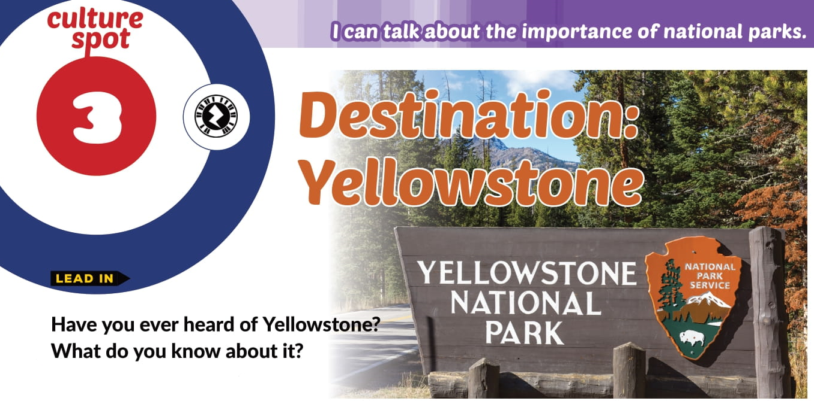

Slide 3
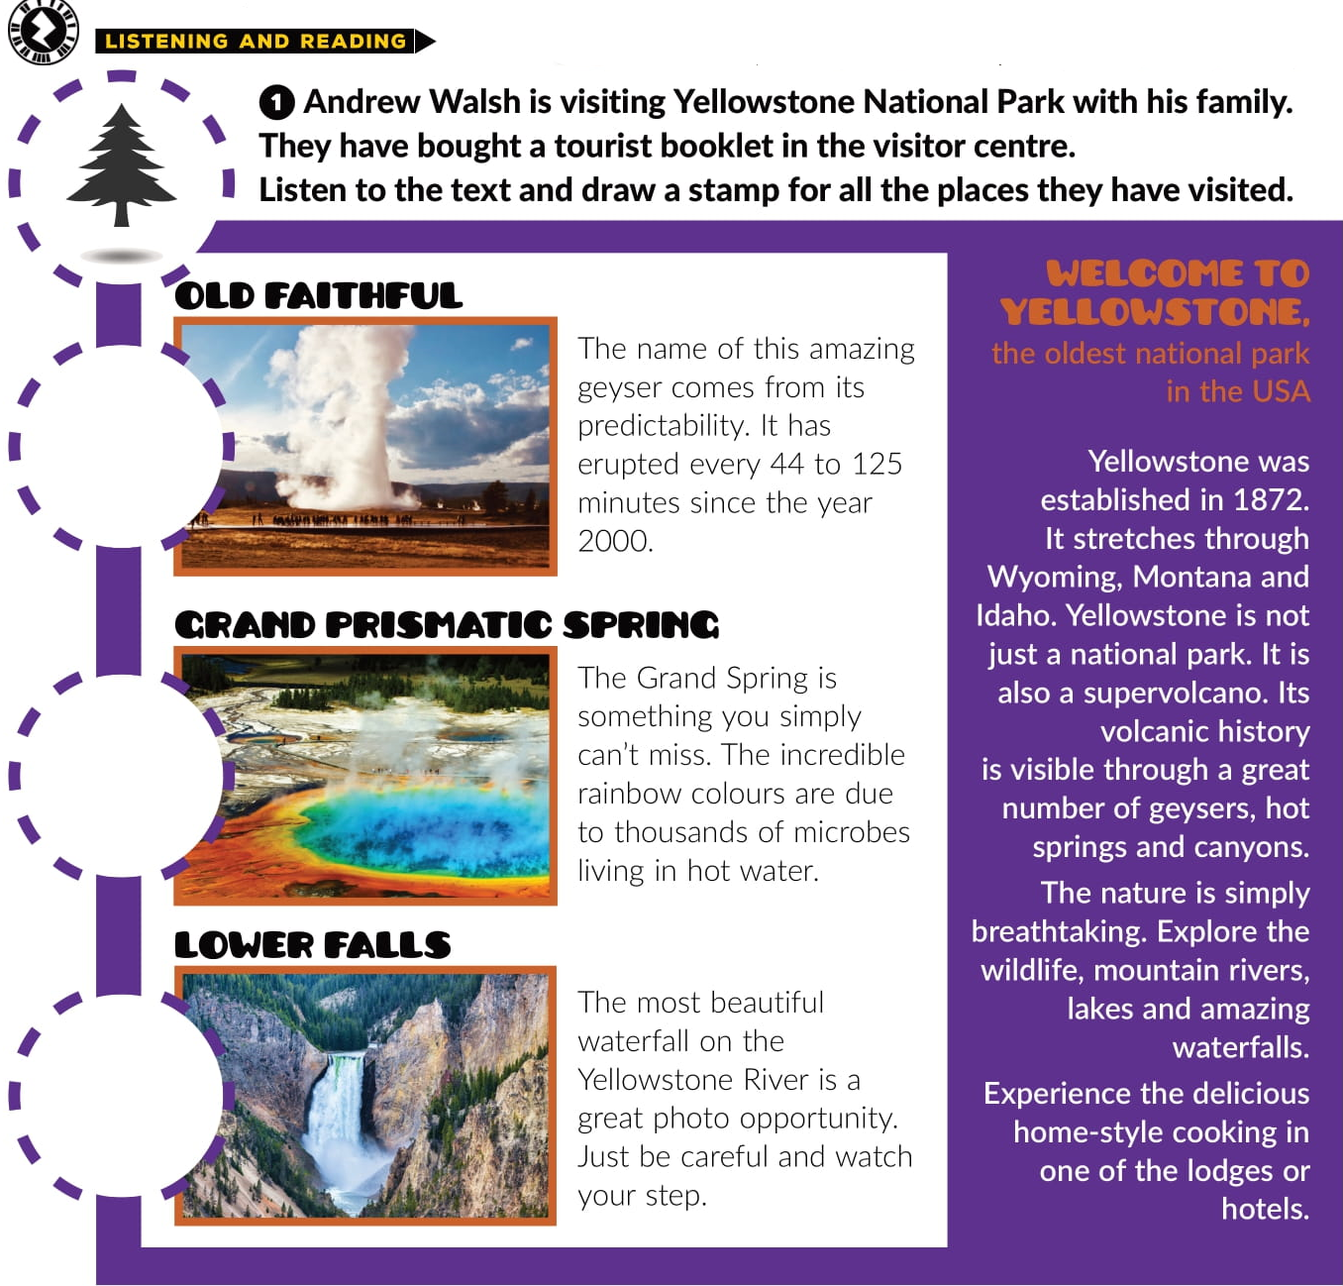

Breathtaking incredible beautiful amazing wildlife

Slide 4
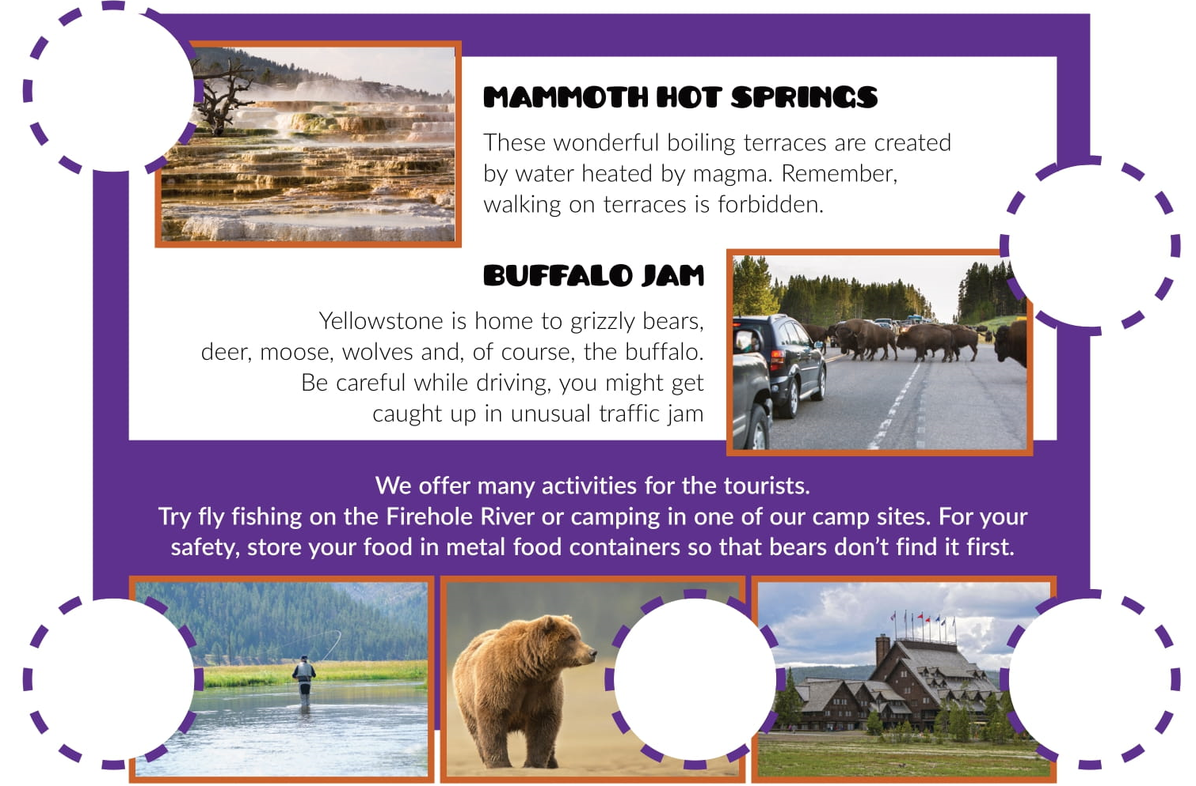

Slide 5
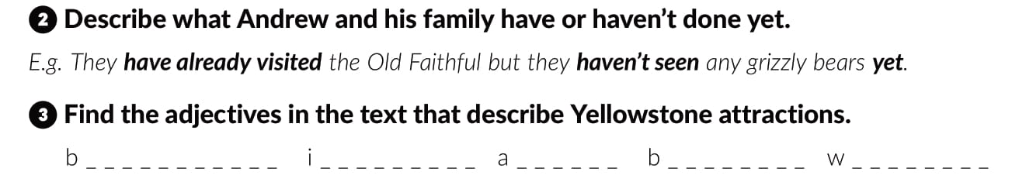
r e a t h t a k i n g
n c r e d i b l e
m a z i n g
e a u t i f u l
o n d e r f u l

Slide 6
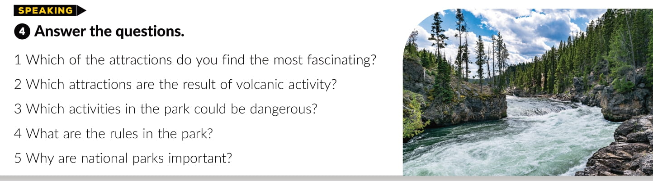
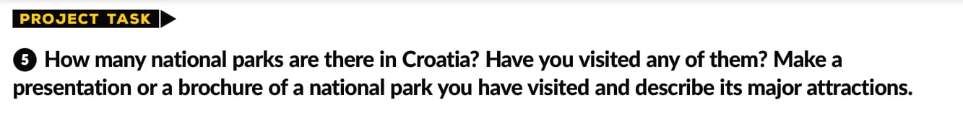

Slide 7
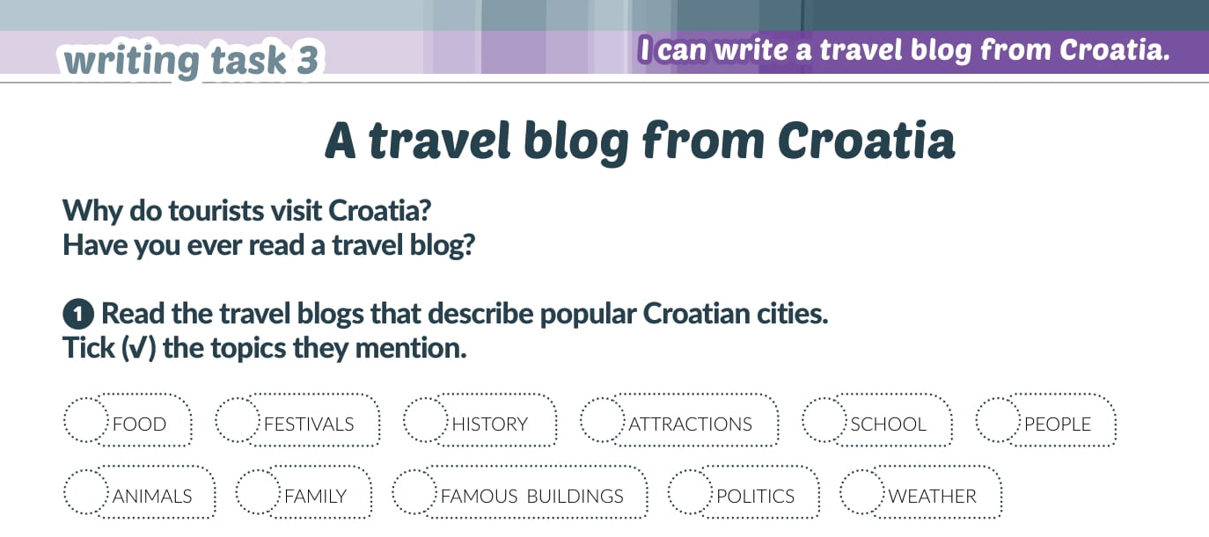

Slide 8
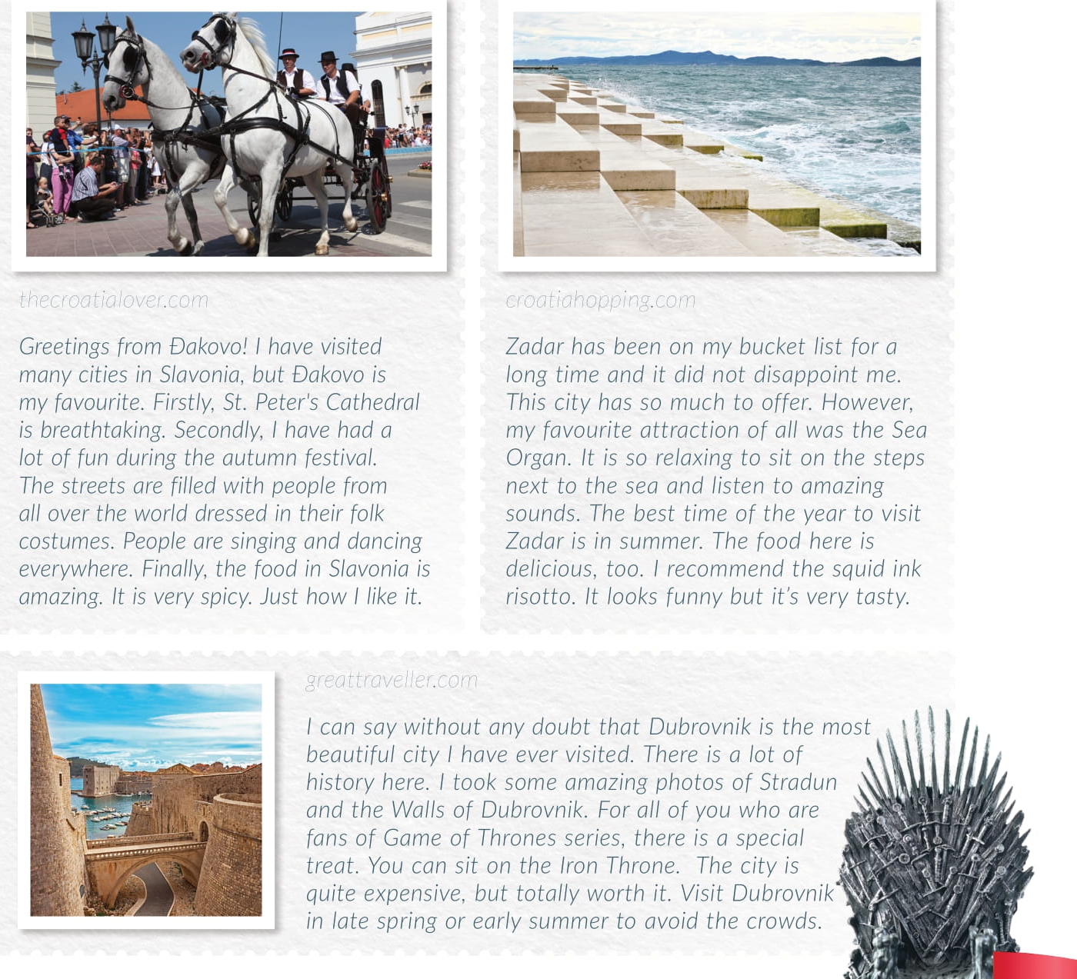

Slide 9
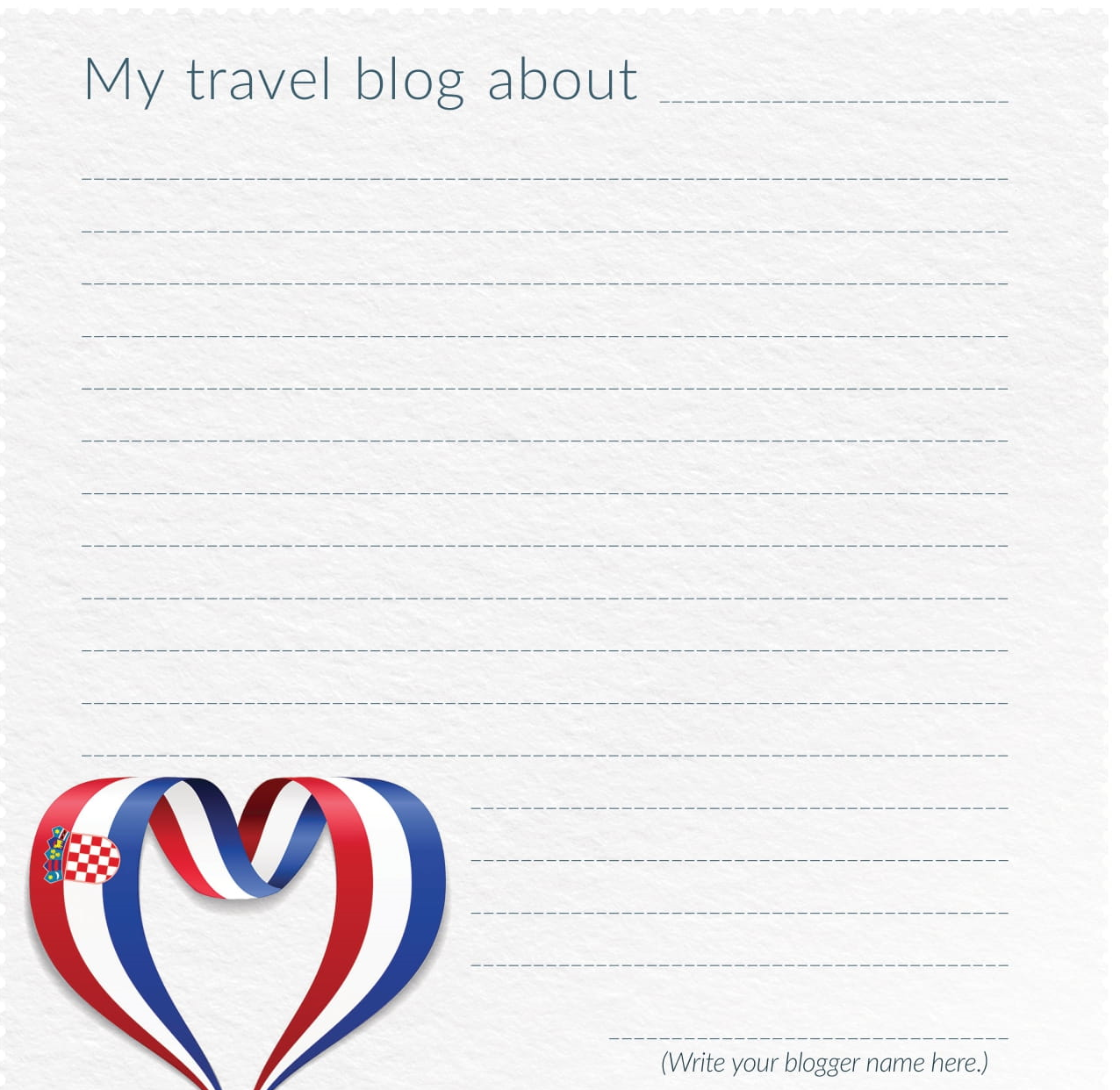
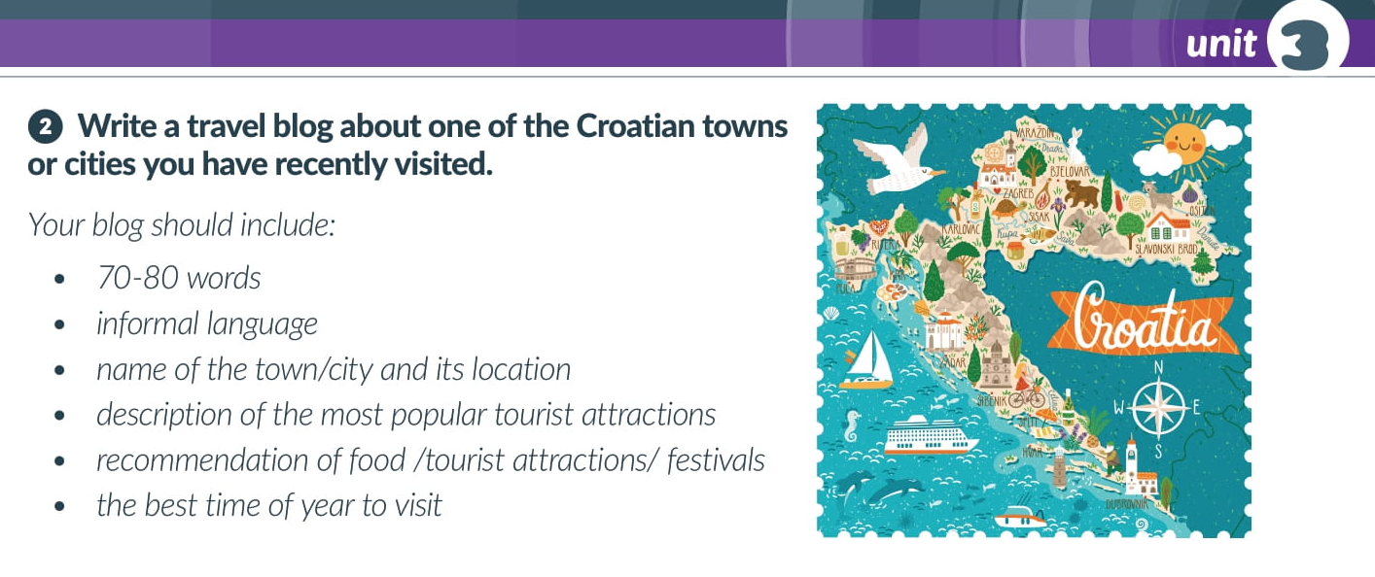

Slide 10
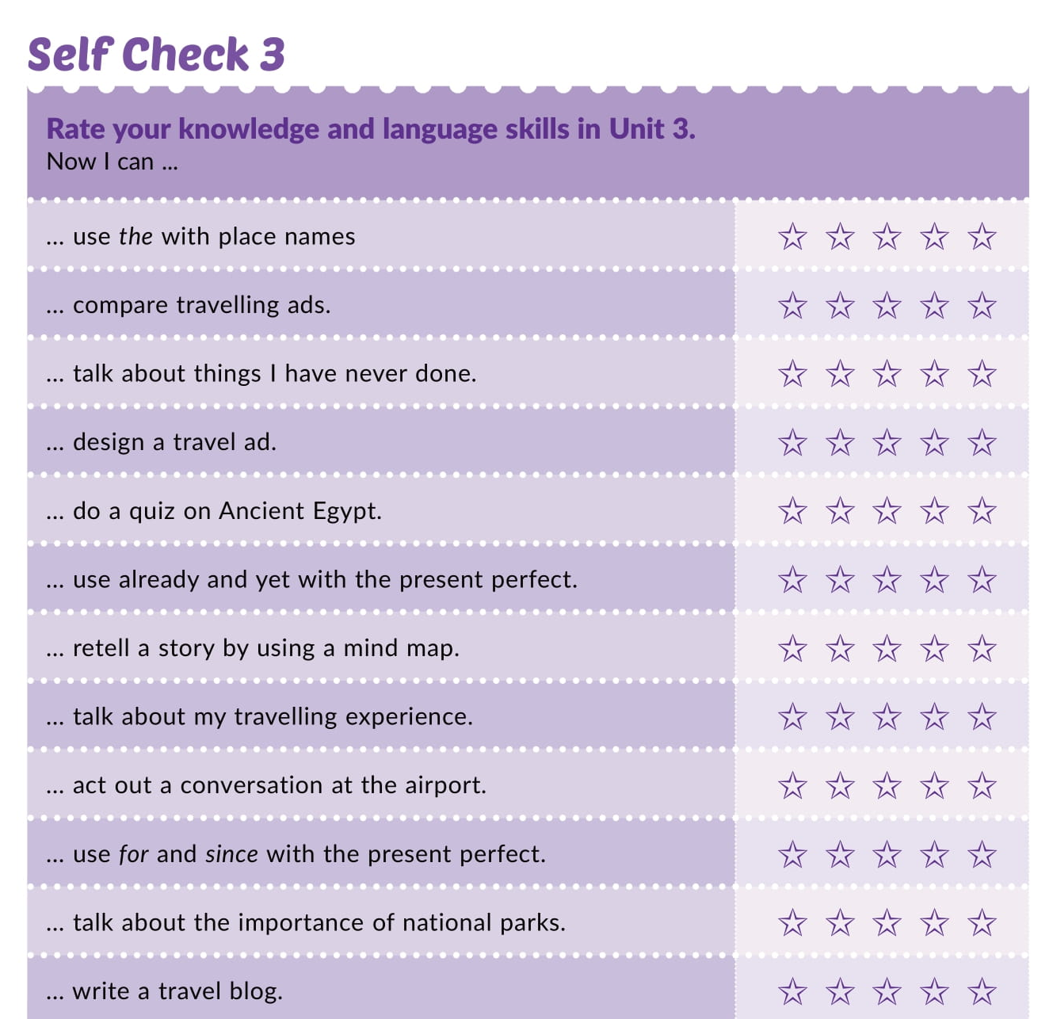
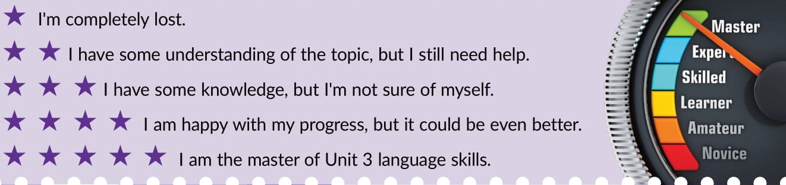

Slide 11
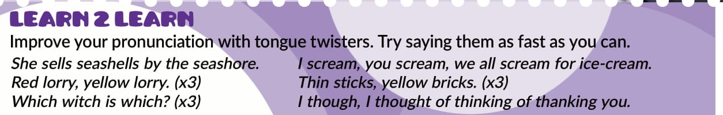

Slide 12

PLAY AND LEARN
Culture spot 3 Destination Yellowstone | Way to go 4 (e-sfera.hr)

